Slide 1
RNA-Seq compared to Proteomics
Overview
October 22nd, 2019

Slide 2
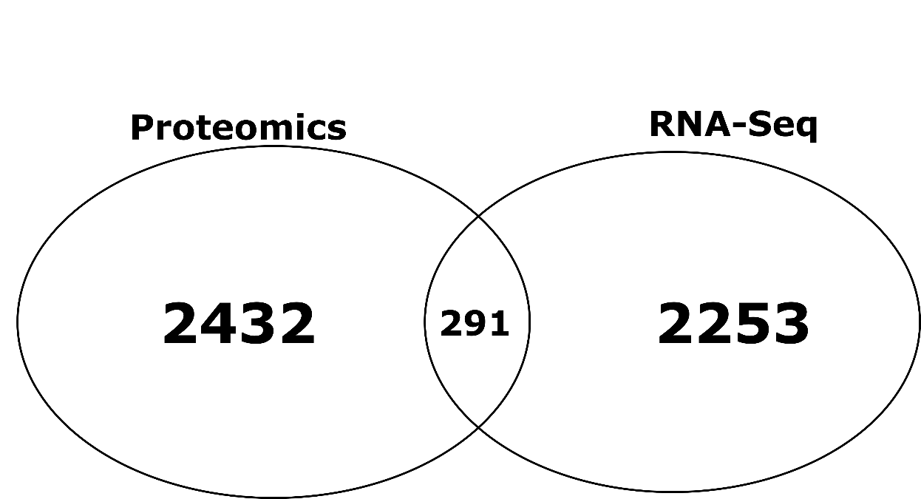
LPSLPS vs Vehicle
 | RNA-Seq | Proteomics
DE genes | 1523 | 2723
Upregulated | 818 | 22
Downregulated | 705 | 2701
RNA-seq
Padj <0.05
log2FC >1.5 | < -1.5
Proteomics
Pvalue <0.05

Slide 3
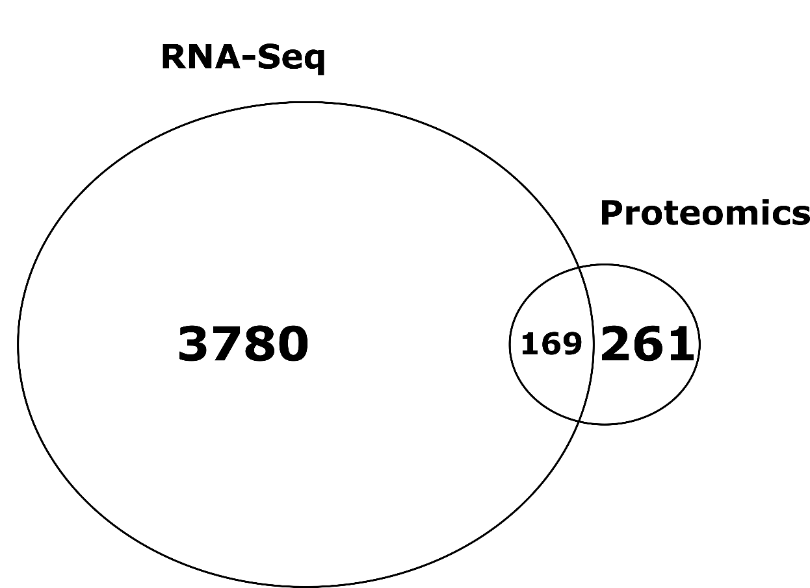
LPS vs Vehicle
 | RNA-Seq | Proteomics
DE genes | 3949 | 430
Upregulated | 1801 | 348
Downregulated | 2148 | 82

Slide 4
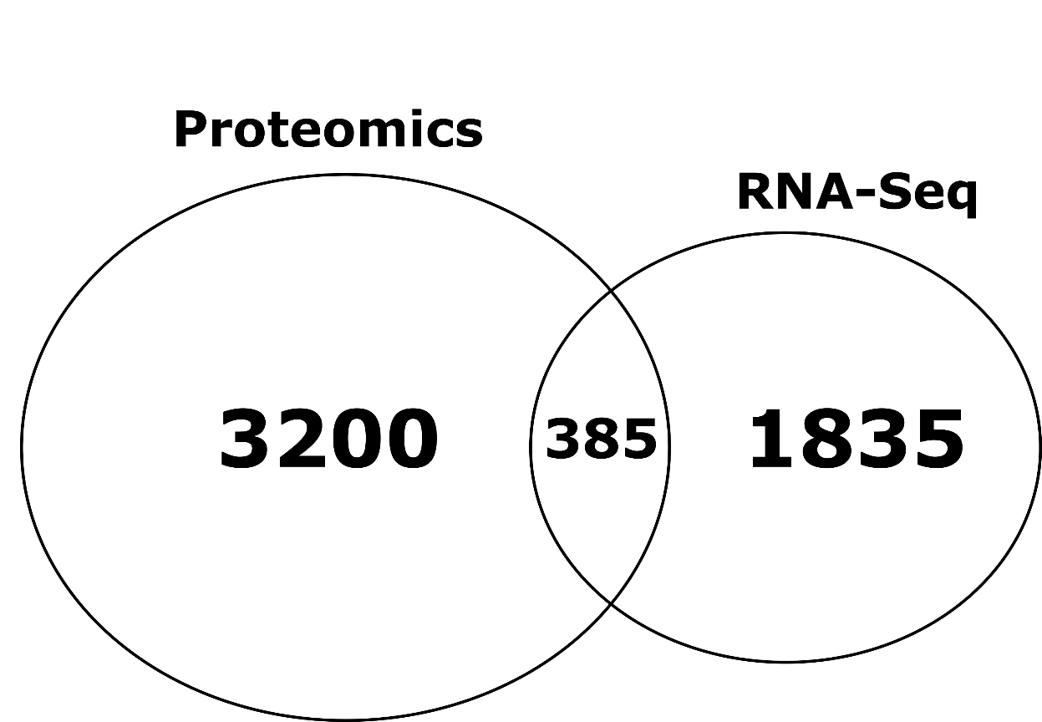
LPSLPS vs LPS
 | RNA-Seq | Proteomics
DE genes | 2219 | 3585
Upregulated | 1167 | 1
Downregulated | 1052 | 3584

